Slide 1
Lecture 1 Introduction to Engineering Graphics To learn more read Ch. 1, pp. 2-5.
IME 222 - Engineering Graphics

Slide 2
What is Engineering Graphics?
A language for communicating ideas in the engineering design process by utilizing precise and neat drawings made of geometric entities
Based on a system of well established rules and conventions that enable us to clearly convey information about an object
CAD software is a tool used for creating graphic documents
Notes:
Standard conventions (like vocabulary in language) allow us to communicate more effectively and with clarity

Slide 3
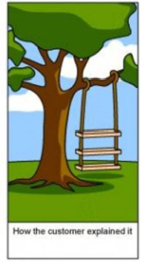


Why Engineering Graphics?
This is how the customer explains it
This is how the design engineer understands it
This is how the production engineer produces it

Slide 4

What the customer really needed!!!

Slide 5
Challenge:
Sketch a component that looks like a fork and has the following characteristics:
i) The component is 2-in long, 1-in high and 1.5-inch deep.
ii) The fork handle is 1-in long and it has a through hole at the end.
iii) There are two fork prongs, each is 1-in long and each has a hole at the end. The handle end and both prong ends are rounded.

Slide 6
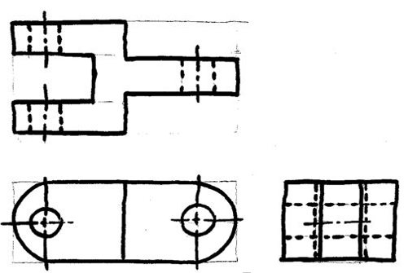
Solution… Really?

Slide 7
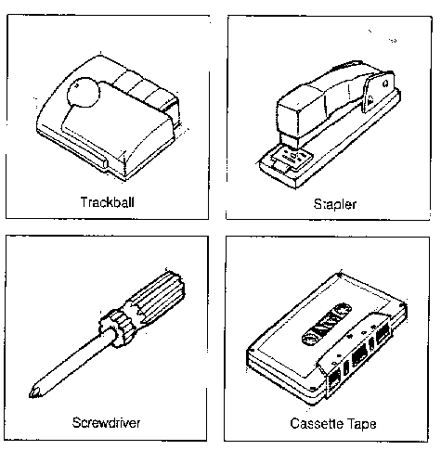
Free Hand Sketching
Isometric sketches of common objects

Slide 8
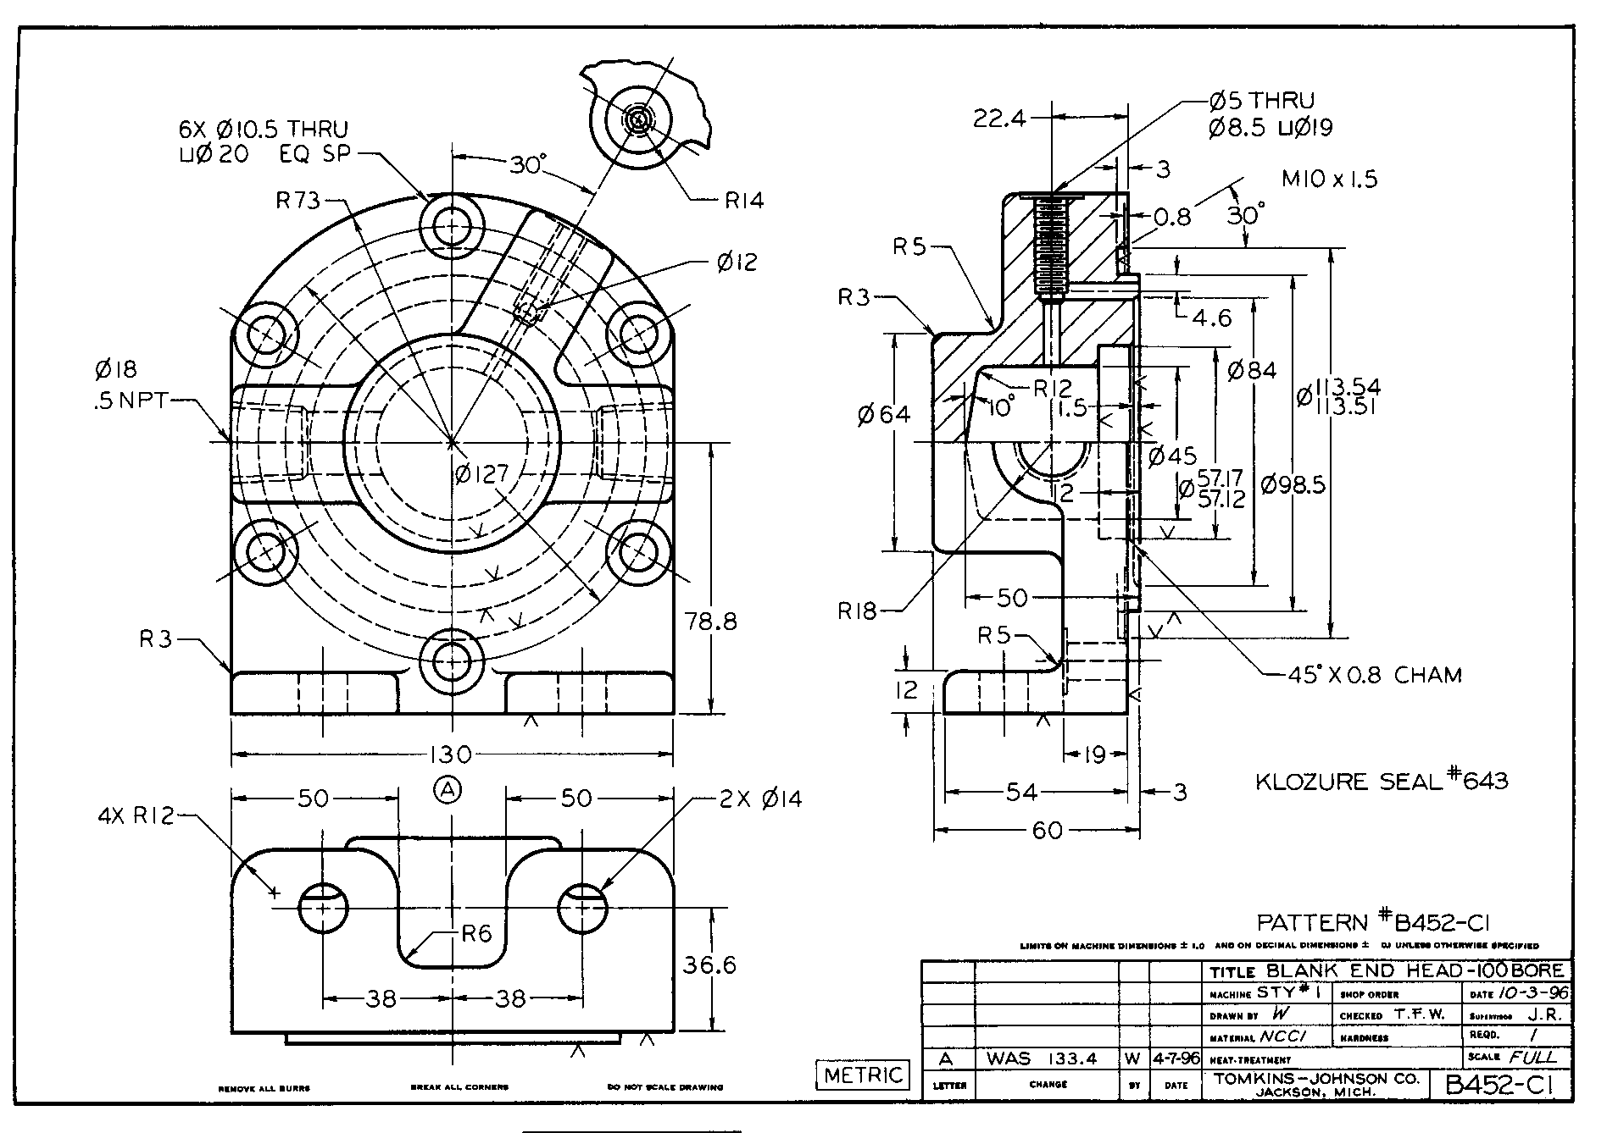
Example of a Detailed Engineering Drawing
“Detailed” means that the drawing has all necessary information to facilitate its manufacture. This includes multi-views, dimensions, tolerances, notes, etc.

